Slide 1
Genetic Variation in miRNA Primary Transcripts
August 22, 2017
Moeen Bagheri
BCB430Y

Slide 2
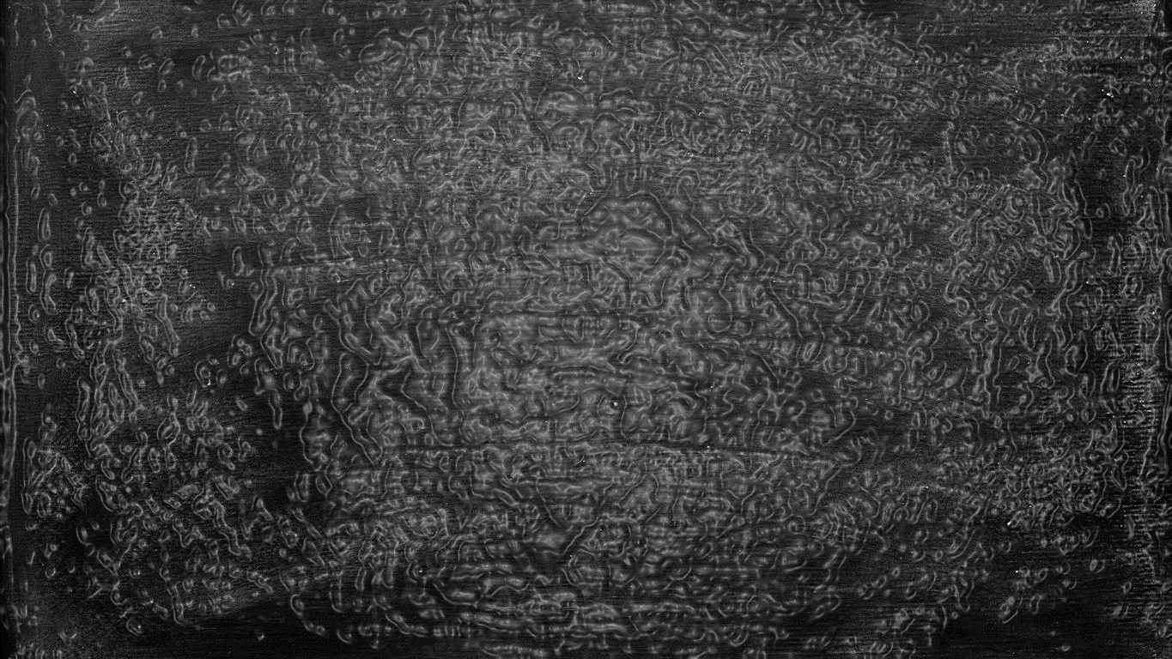
Overview
Project Description
Objective
Results
Materials and Methods
Finding genetic variations
Estimating degree of variation
Finding characteristic SNPs
Results
Pairwise degree of variation
Clustering & dendrogram
Characteristic SNPs
Questions & Discussion
Conclusion

Slide 3
Project Description
Objective
Results
Evaluate the genetic variation in human populations based on data from the Phase III of 1000 genomes project.
Identify SNPs that are unique to certain populations and, hence, could have emerged due to positive selection.
Heat-map of genetic distances
Dendrogram
Characteristic SNPs

Slide 4
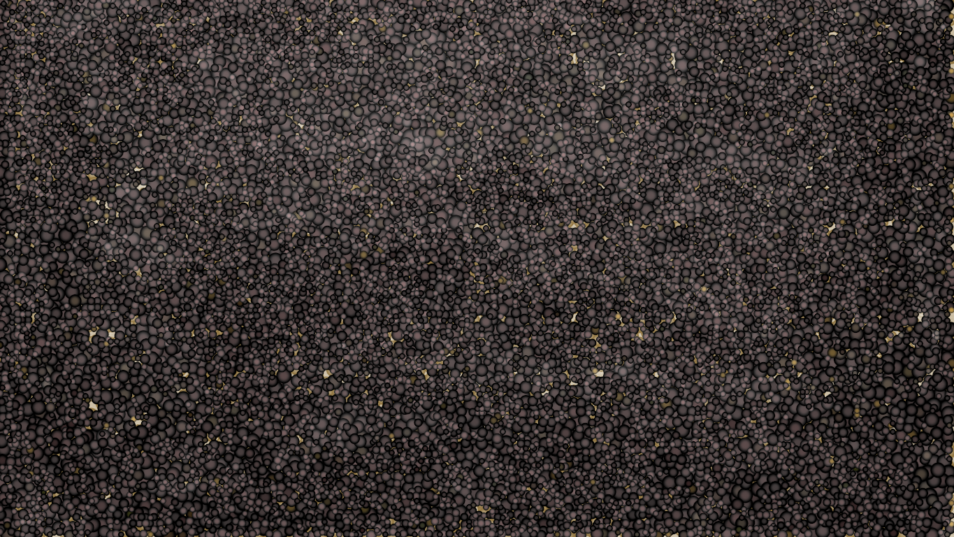
Finding Genetic Variations
Materials & Methods

Slide 5



Data collection
miRNA genome coordinates
obtained from miRBase v21: mirbase.org
file format: Generic Feature Format (.gff3)
Human genomes
obtained from phase III of 1000 genomes project: internationalgenome.org
file format: Variant Call Format (.vcf)
Reference genome: GRCh38

Slide 6
Data collection
miRBase:
Extract the genomic coordinates of miRNA primary transcripts.
A total of 1881 miRNA primary transcripts were obtained.
1000 genomes:
original VCF files were separated based on chromosome number.
The genomic data for each population was then separated using BCFtools.
A total of 2503 samples from 26 populations and 5 different demographic areas were obtained.

Slide 7

Finding genetic variations
The coordinate range of each miRNA primary transcript was searched in the VCF files for genomic variations.
Using R programming language
A total of 1127 variations were found.
Three measures:
SNP frequencies
Variation frequencies
Total-variation frequencies
SNP frequency
Variation frequency
Total-variation frequency
miRNA coordinates
Search
VCF files for subpopulation X
Compute
Output
results.tsv

Slide 8
Estimating Degree of Variation in Frequencies
Materials & Methods

Slide 9

Estimating degree of variation
1. Variance
Average of all variances
SNP frequency
results.tsv
2. Variation frequency
Estimate genetic distances per locus
Genome-wide genetic distance
3. Total-variation frequency
Average of ratios
2. Fixation index
Ratio of averages

Slide 10
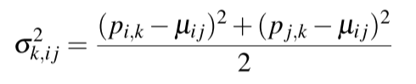
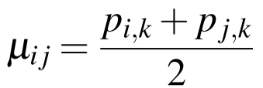
Estimating genetic distance using variance
1. Variance
SNP frequency
Simply calculate the variance of the frequencies between two subpopulations, at that locus.
results.tsv
2. Variation frequency
Estimate genetic distances per locus
3. Total-variation frequency

Slide 11
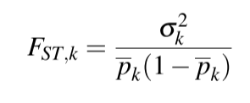
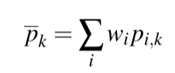
Estimating genetic distance using fixation index (FST)
A measure of population differentiation due to genetics.
Weighted by the size of each subpopulation.
SNP frequency
results.tsv
2. Variation frequency
Estimate genetic distances per locus
Value between 0 and 1.
3. Total-variation frequency
2. Fixation index

Slide 12
Estimating genome-wide genetic distance
1. Variance
Average of all variances
SNP frequency
results.tsv
2. Variation frequency
Estimate genetic distances per locus
Genome-wide genetic distance
3. Total-variation frequency
Average of ratios
2. Fixation index
Ratio of averages

Slide 13
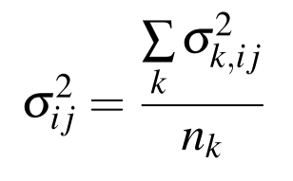
Estimating genome-wide genetic distance from variance
Simply take the average of all variances across all loci.
1. Variance
Average of all variances
genetic distances per locus
Genome-wide genetic distance

Slide 14
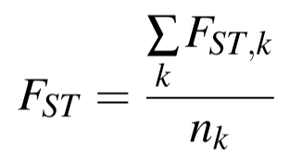
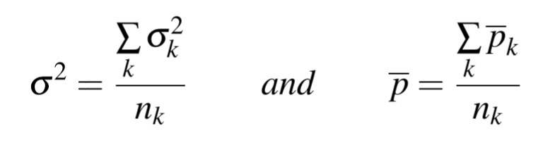
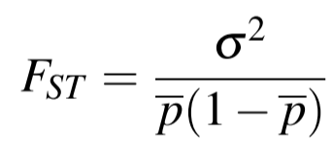

Estimating genome-wide genetic distance from FST
Ratio of averages
Average of ratios
Calculate variance and $\overline{p}$ at each locus.
Average variances and $\overline{p}$ values across all loci.
Calculate a new FST value from the averages.
Obtain genome-wide FST by taking the average across all loci.
genetic distances per locus
Genome-wide genetic distance
Average of ratios
2. Fixation index
Ratio of averages

Slide 15
Estimating pairwise genetic distances
This process was performed between all possible pairs of subpopulations to obtain a 26 × 26 matrix for each frequency measure (SNP, variation, and total-variation) and each statistical method (variance and FST).
Plot square matrices as heat-maps using R.
Compare heat-maps and select the superior method & measure.
Perform clustering on the chosen matrix and plot the results as a dendrogram.
Also, construct a 5 × 5 matrix for super-populations using the chosen method & measure.

Slide 16
Pairwise Degree of Variation
Results

Slide 17
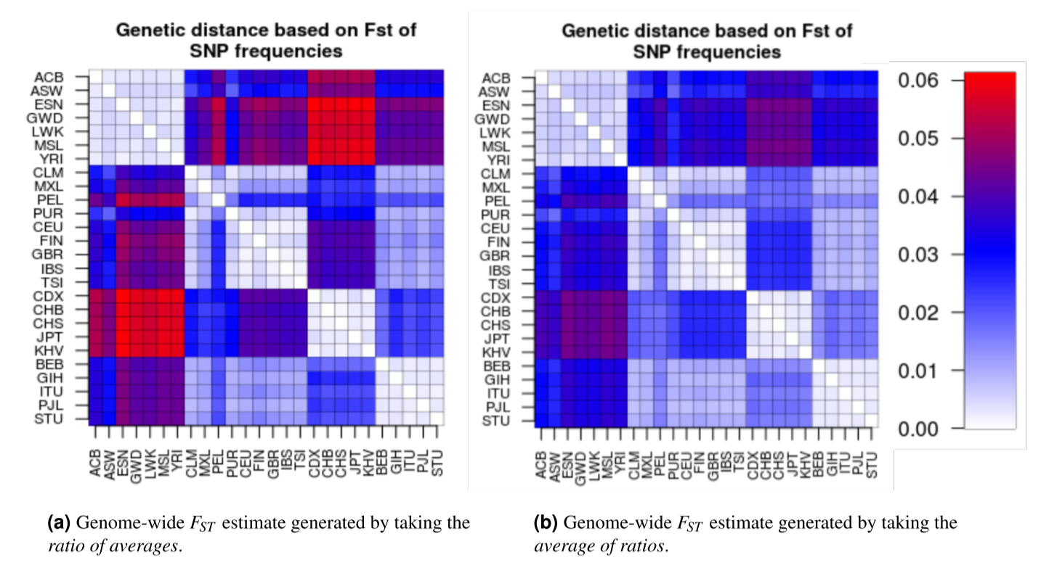
Genome-wide FST estimates
Under-estimation of genetic distances when using “Average of ratios”
Therefore, “Ratio of averages” was chosen as the method of choice for the rest of the study.
Ratio of averages
Average of ratios

Slide 18
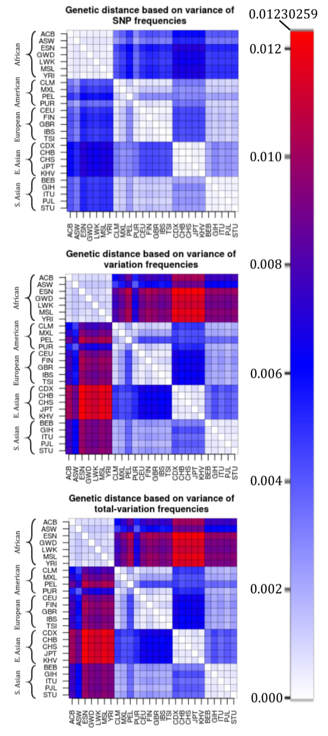
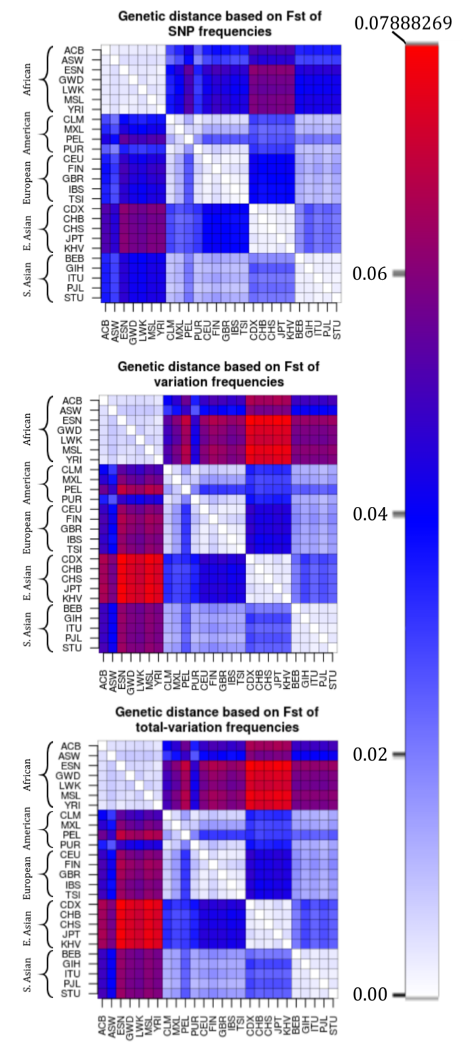
Pairwise genetic distances
Variance
FST
Variance vs. FST:
Variance and FST plots seem to agree/correlate with each other.
However, FST takes into account the size of each subpopulation, and hence, it is a more accurate method
Therefore, FST was chosen as the statistical method of choice for estimating genetic distance.
SNP vs. variation vs. total-variation frequencies:
Again, these three measures agree with each other.
Variation and total-variation seem to emphasize the genetic distances.
However, since SNP frequencies is a more accurate measure of genetic distance and the ultimate goal of this study is to find characteristic SNPs, SNP frequencies was chosen as the measure of choice.

Slide 19
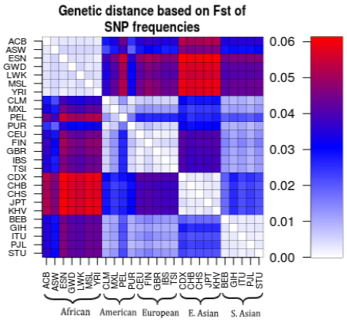
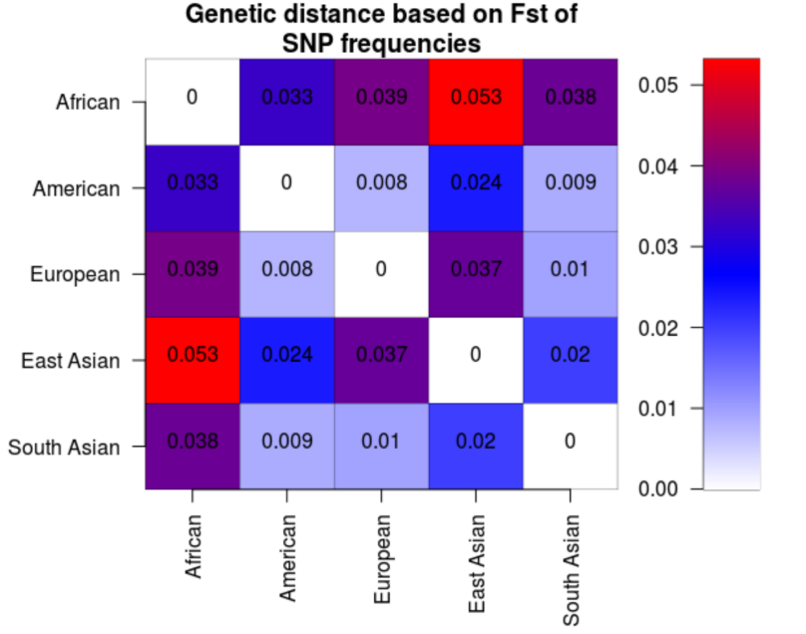
Heat-map of genetic distances
The genetic distance of members of the same super-population is very low.
African subpopulations have the highest genetic distances.
Americans, Europeans, and South Asians are close to each other.
East Asians are considerably different than all other subpopulations, but they are the closest to South Asians.
The highest FST value (~0.061) occurred between the African subpopulation ESN and the East Asian subpopulation CDX.

Slide 20
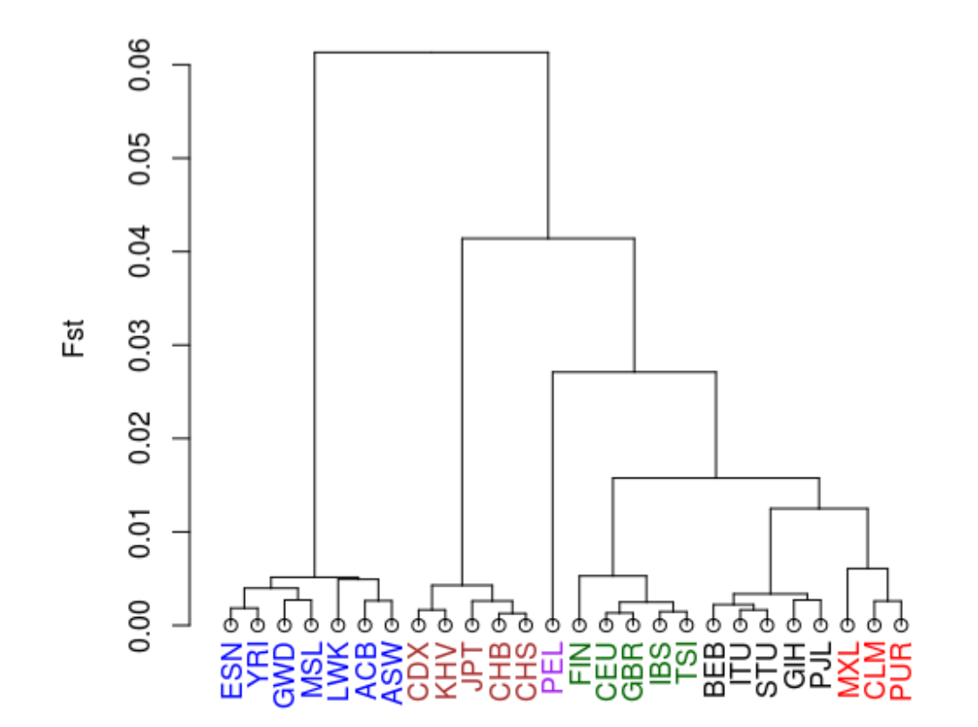
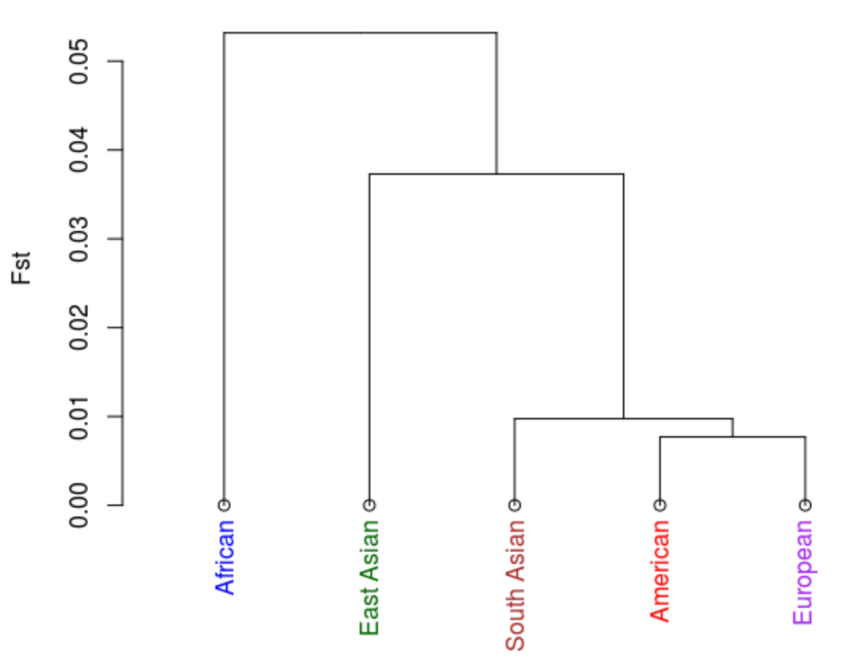
Clustering & dendrogram
The subpopulations were then clustered based on their genetic distances.
A dendrogram of the results was constructed.
All subpopulations were clustered in their appropriate super-population, as expected, with the exception of PEL.

Slide 21
Finding Characteristic SNPs
Materials & Methods

Slide 22
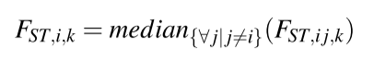
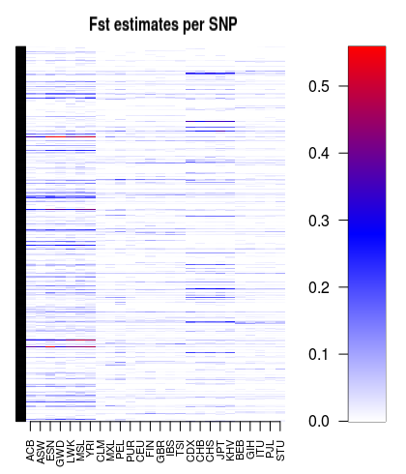
Finding characteristic SNPs
Definition: SNPs that are unique to certain populations, and hence, may have emerged as a result of positive selection.
results.tsv
Estimate degree of variation in frequency per SNP
1127 of 26 × 26 matrices
Median of all FST values of each population for a single SNP
Single FST value for each population and for each SNP
SNP frequency
Degree of difference in the frequency of that SNP for each population
Repeat for all SNPs
1127 × 26 matrix
Next Page

Slide 23
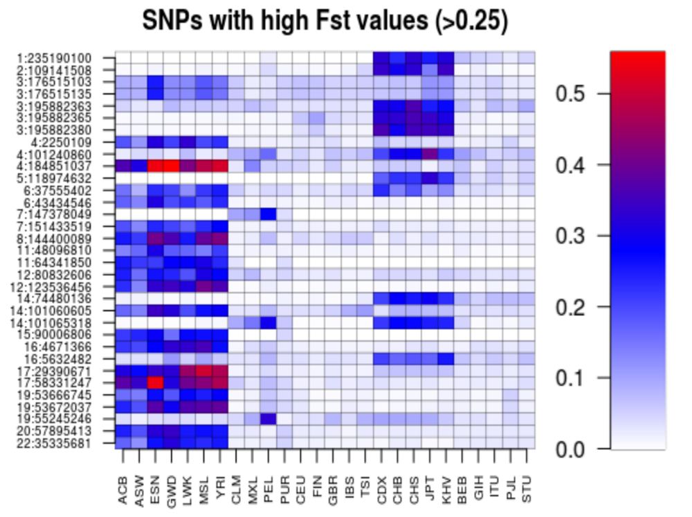
Finding characteristic SNPs
To find characteristic SNPs, 0.25 was chosen as the cut-off between FST values that signify unique versus common SNP's.
1127 × 26 matrix
Filter rows with at least one FST value > 0.25
33 × 26 matrix

Slide 24
Characteristic SNPs
Results

Slide 25
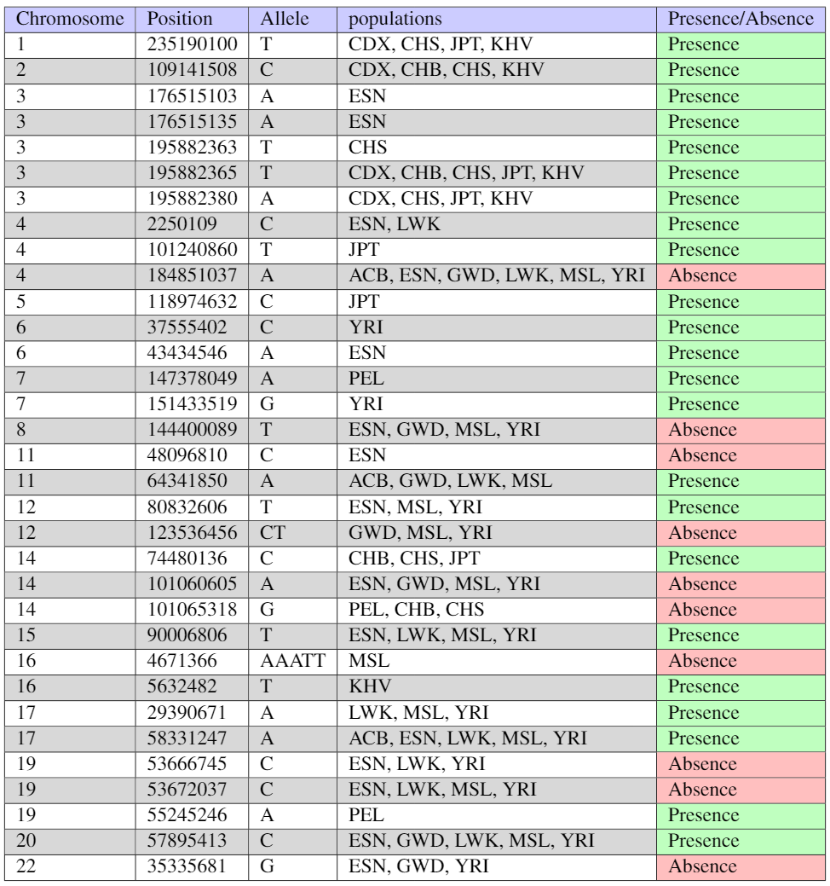
Finding characteristic SNPs
A total of 33 characteristic SNPs were found.

Slide 26
Questions & Discussions

Slide 27
Questions & Discussions
Q) Why averaging over all SNPs rather than taking the median when calculating genome-wide genetic distances?
Averaging was chosen over taking the median since I wanted the outliers to have a strong effect on the genetic distance estimate between two subpopulations, because it is these outliers that contribute to the difference between subpopulations.
Q) Why taking the median of pairwise distances rather than averaging when calculating genetic distances per SNP?
Median was chosen instead of the average since we want to find whether a subpopulation has a high or low genetic distance with more than half of the subpopulations.

Slide 28

Questions & Discussions
Clustering & Dendrogram:
Surprisingly, subpopulation PEL was not clustered with any demographic area.
Q) Why did PEL not cluster with other American populations?
Looking at the heat-map, PEL is fairly different than other American subpopulations.
For example, American subpopulations are listed to be close with Europeans and South Asians, with the exception of PEL.
This result could imply that the subpopulation PEL has been relatively isolated compared to other American subpopulations.

Slide 29
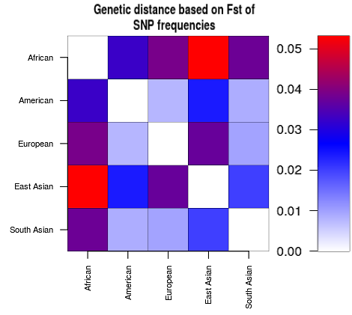
Questions & Discussions
The dendrogram and heat-map of super-populations agree with each other.
Heat-map
Africans have the highest genetic distance.
East Asians are considerably different than others as well.
American, European, and South Asians are fairly close to each other.
Dendrogram
Africans were diverged first.
East Asians were diverged next.
Lastly, South Asians diverged from Americans and Europeans.

Slide 30

Questions & Discussions
Q) When finding characteristic SNPs, why did we choose a value of 0.25 as the cut-off?
Consensus on interpretation of FST:
FST < 0.05 : Little genetic variation,
0.05 < FST < 0.015 : Moderate genetic variation,
0.15 < FST < 0.25 : Great genetic variation,
FST > 0.25 : Very high genetic variation.
The value 0.25 was chosen since an FST value greater than 0.25 is considered to represent a very high degree of genetic variation.

